Slide 1
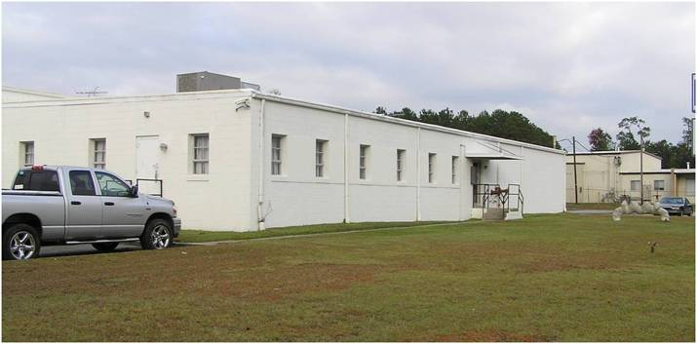
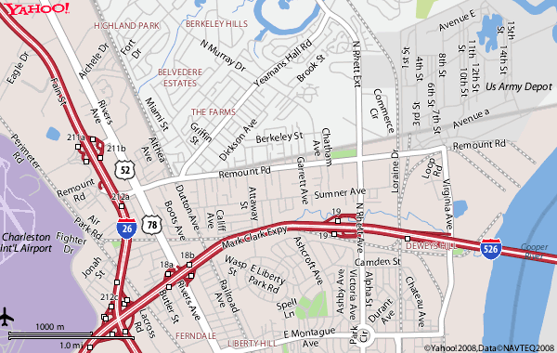
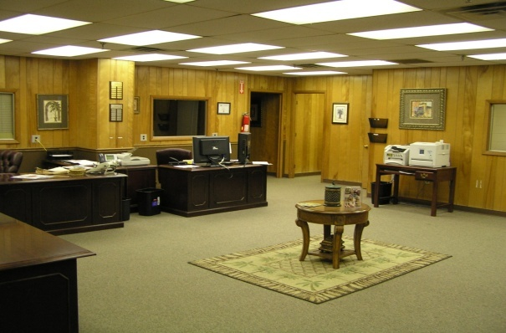

For Lease
909-A Commerce Circle
N. Charleston, SC 29405
3,400sf of a 5,700sf office / flex suite
located in close proximity to the State
Port Authority North Charleston Terminal,
and the Charleston Naval Weapons
Station.
Good frontage, sign space and ample
parking.
Owner will consider leasing entirety of the
office suite
Space could be leased in a furnished
state for additional rents.
Space could be available as early as mid
December.
$ 3,500 / mo / Lease term negotiable
Rent includes normal utilities, base years
taxes, insurance and CAM.
Floor plan on reverse side
14,940 sf / $ 5,600 /mo*
Sale Price: $599,000
PORT!
Directions:
From I-26, take I-526 East to N. Rhett exit, turn left at bottom of ramp, Commerce Circle will be 1 miles down on the right just past the railroad tracks.
OFFERED BY CARR PROPERTIES, LLC
Offered by Carr Properties, LLC
843-744-2863 office
843-744-0321 fax
www.carr-properties.com
carrpropllc@aol.com
5806 Campbell St, Hanahan, SC 29410
Office: 843-744-2863 Fax: 843-744-0321
Email: carrpropllc@aol.com
www.carr-properties.com
COMMERCIAL REAL ESTATE ~ SALES ~ LEASING ~ MANAGEMENT ~ DEVELOPMENT

